Slide 1
NJ Health Insurance Mandate
New Jersey Slides
Tax Year 2019

Slide 2
New Jersey Health Insurance Mandate
NJ Health Insurance Mandate
Must have minimum essential coverage unless you qualify for an exemption
22 exemptions available; similar to ACA (see next slides)
Claim exemption on Sch NJ-HCC on tax return
If no health insurance, must pay shared responsibility payment (SRP). Calculated on Worksheet L
SRP capped at statewide average premium for Bronze health plans in NJ
SRP is subject to same penalties and interest as NJ Income Tax
Automatically exempt if not required to file NJ return
Notes:
This is the place to list local materials unique to your training area

Slide 3
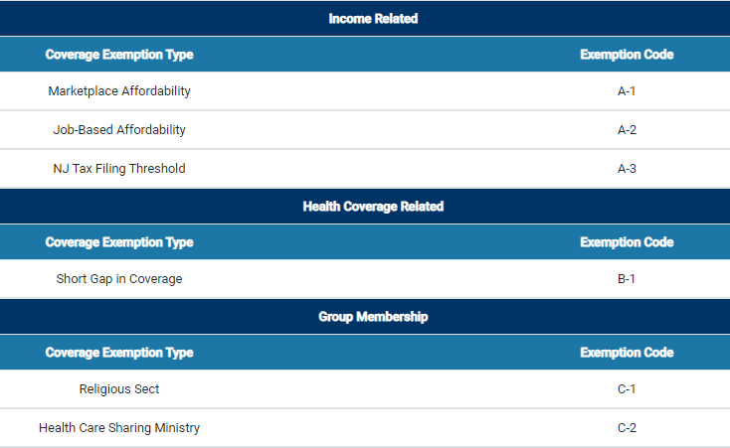
Possible Exemptions From NJ SRP

Slide 4
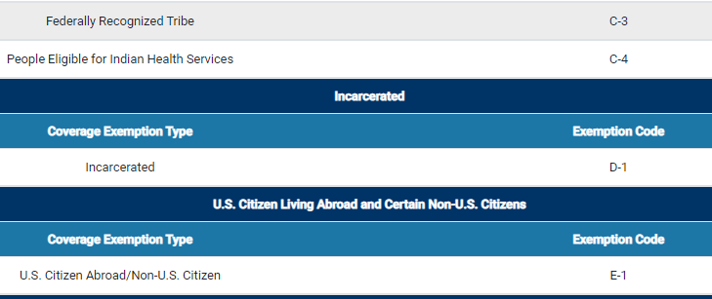
Possible Exemptions From NJ SRP

Slide 5
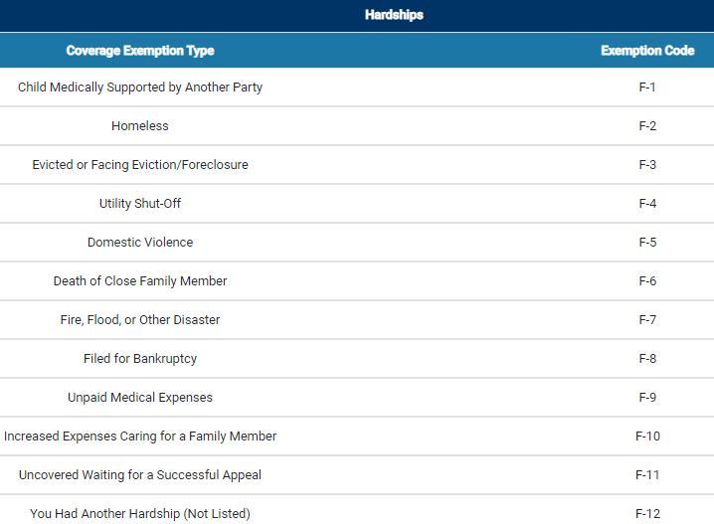
Possible Exemptions From NJ SRP

